Slide 1
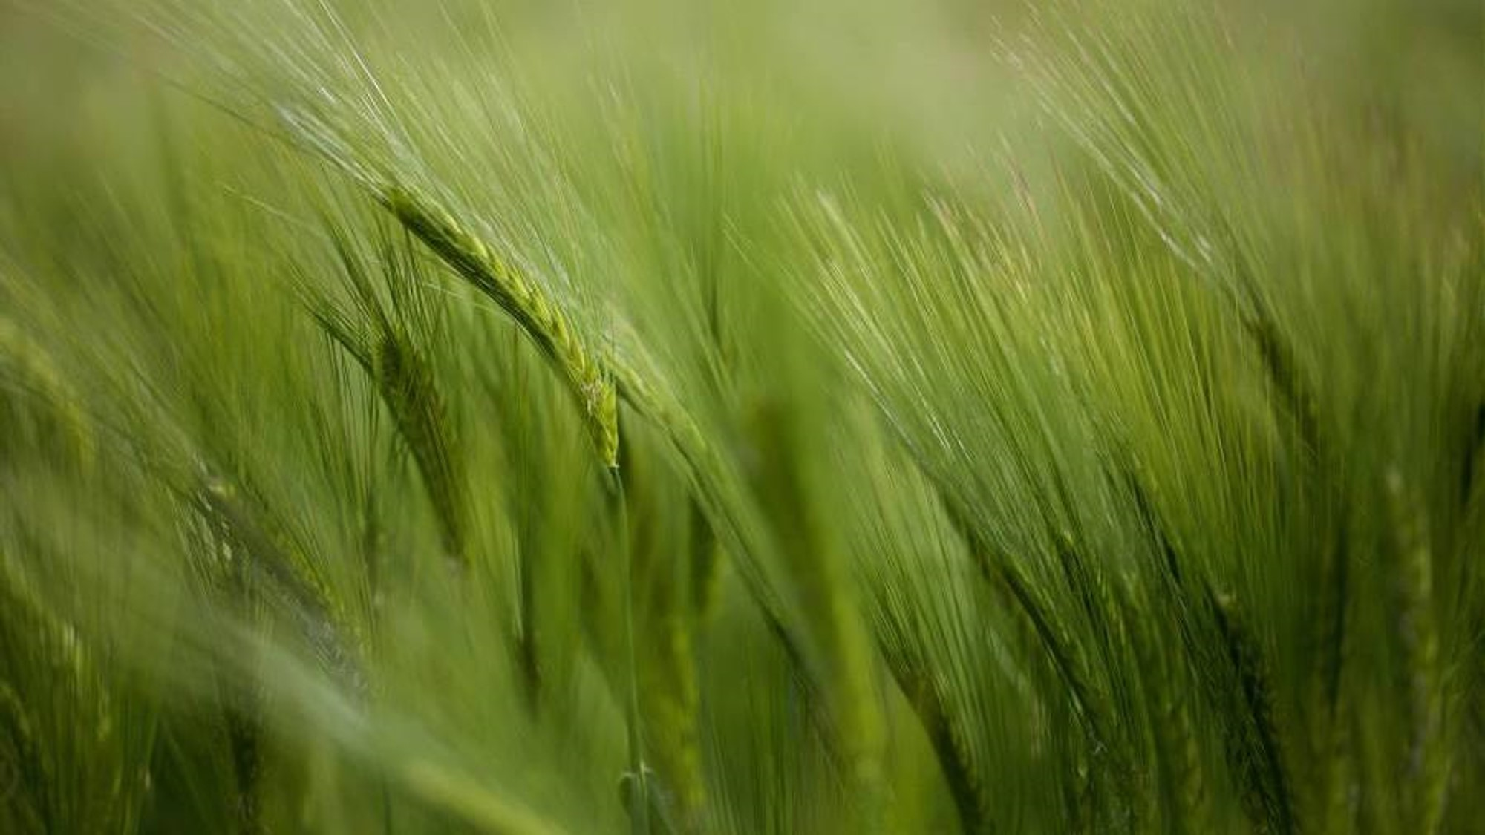
Crop Production Analysis in India

Slide 2

The reason & goal
The agriculture business, a vital part of the supply chain, is set to evolve significantly with advancements in the Future Internet. The dataset used in this project offers extensive information on crop production in India over several years. The goal is to predict crop production and uncover key indicators and metrics that influence it.

Slide 3

Data and SIGNIFICANCE
The dataset used here consists of important information like:
State: Names of all states
District: Names of all states within these states
Year: The year in which this data was recorded
Season: The season in which this data was recorded
Crop: The name of crop
KPI’s: Key Performance Indicators
Area: The area under cultivation
Production: Total amount of crop produced

Slide 4
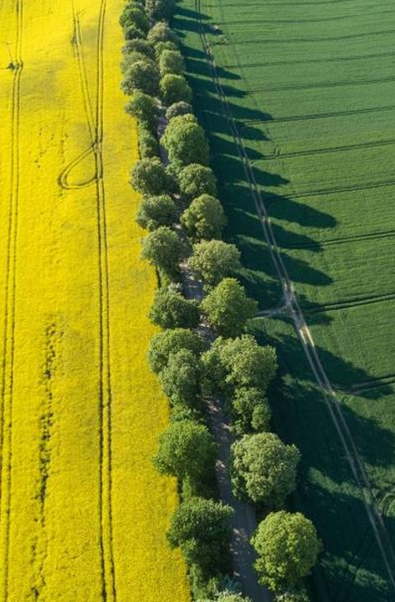
The Approach
Find the production and area under cultivation over the year.
Find crops with the highest production to area ratio and reasons for the same.
Find state wise distribution of area under cultivation and relevant crop information.
Find state wise distribution of total crop production and relevant crop information.
Find relation between production and area.
Find top crops grown in most states and relevant crop information like production over the years/seasons.
Find correlation between different crop attributes using machine learning.

Slide 5

Analysis
Crop production in general has increased over the years, hitting the highest in 2011 and 2013, respectively.
Area of cultivation has decreased over years, even though area is reduced but the production has increased.
It's pretty evident that by weight more coconuts are cultivated in the same area when compared to other crops, due to their weight even though the tree requires more area to grow.
Overall production of crops like coconut has increased over the years.

Slide 6
Analysis
Uttar Pradesh has the largest area under cultivation where crops like sugarcane are produced the most. Due to less production to area ratio of most crops, the total production in Uttar Pradesh is comparatively less.
Despite having one of the smallest areas of cultivation, Kerala leads in crop production, primarily due to its high yield of crops like coconut.
Crops like coconut are grown throughout the year in Kerala, in most cases the production tends to increase with area under cultivation. Similar trends are visible for the state of Andhra Pradesh.

Slide 7
Analysis
Rice is produced in most states followed by sugarcane, maize, rapeseed, mustard and wheat. Among which sugarcane production is the maximum and tends to grow over time.
Rice and paddy cultivation is in almost all seasons whereas crops like oilseeds, maize, cotton and wheat are strictly seasonal.
Winter crops provide the most production throughout the years followed by kharif crops.

Slide 8
Analysis
Out of all the attributes crop type and area under cultivation possess better correlation.
The most important attribute contributing to any crop production is the crop type followed by area and the region where it is grown.
To maximize the crop production, we need to select the best crop to cultivate like coconut which even though takes a lot of land still provides best production. We can also choose other crops that show similar trends like sugarcane, rice and wheat.

Slide 9

Thank you
Tools:
Jupyter Notebook.
Python - Numpy, Pandas, Matplotlib, Seaborn, Scikit-learn.
Excel.
GitHub.
Jupyter nbviewer.
Adarsh Niranjan​​
adi.singh.niranjan@gmail.com
https://github.com/adarsh-niranjan
https://www.linkedin.com/in/adarshniranjan/

